Slide 1

Los Angeles Crime Prediction
Group 6: Shubham Parulekar,
Yuran Zhang, Gayatri Mahindrakar

Slide 2
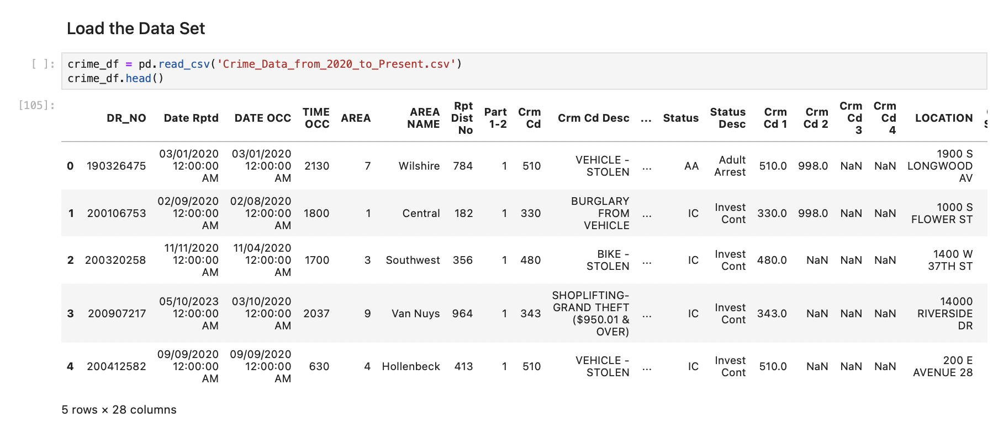
Project Overview
Objective: Predict crime type (classification) and crime occurrence over time (time series) for better resource allocation
Tools: AWS SageMaker, Python (Pandas, XGBoost, LightGBM, SMOTE, SVD, KMeans), Matplotlib.
Data: LAPD Crime Dataset (2020–2025) stored in AWS S3.
Notes:
Good morning, everyone. We are Group 6, and today we will present our final project for IS 597: ‘A Data-Driven Approach to Crime Analysis in Los Angeles.’
I’m Yuran Zhang and we’ll walk you through our motivation, data sources, methodology, model building in AWS SageMaker, key results, challenges, and next steps.

Slide 3
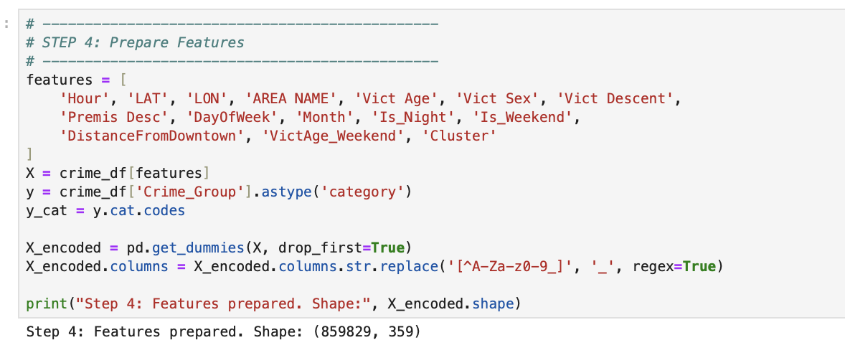
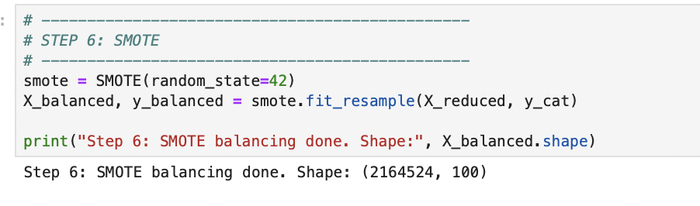
Methodology (Classification Model)
Approach: Classification into "Assault," "Burglary," and "Other" categories.
Algorithms: XGBoost, Random Forest and LightGBM selected for their ability to handle imbalance and complex features.
Feature Engineering:
Temporal (Hour, DayOfWeek, Is_Night, Is_Weekend)
Spatial (LAT, LON, Distance from Downtown, Cluster ID)
Demographic (Vict Age, Sex, Descent, Premise Type)
Data Splitting: 80/20 stratified split for train/test.
Hyperparameter Tuning: Adjusted max_depth, n_estimators, learning_rate (for boosting models).
Class Balancing: SMOTE applied after SVD dimensionality reduction to avoid overfitting.
Dimensionality Reduction: TruncatedSVD used to reduce sparse one-hot encoded features.

Slide 4
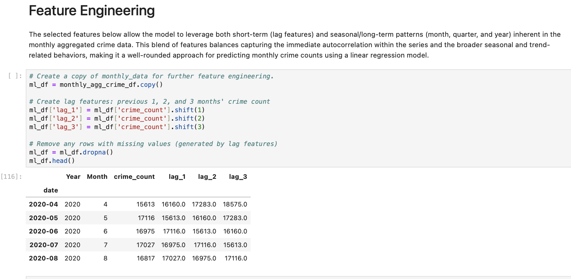
Methodology (Forecasting Model)
Approach: Time series forecasting of future monthly crime volumes.
Algorithms: Both statistical and ML models
Linear Regression: To establish a simple baseline for interpretability and speed.
Random Forest: To capture non-linear relationships and complex interactions.
SARIMAX: To model seasonality, trends, and include exogenous variables explicitly.
Feature Engineering:
Aggregated crime counts by Month and Year.
Rolling average windows for smoothing (e.g., 3-month averages).
Feature selection: lag_1, lag_2, lag_3, year, month
Data Splitting: 2020–2023 for training (80%) , 2024 reserved for testing (20%)
Hyperparameter Tuning: Grid Search to find best (p, d, q) and seasonal (P, D, Q, s) values for SARIMA.
Trend Decomposition: Seasonal Decompose to better capture yearly patterns before modeling.

Slide 5




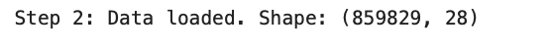
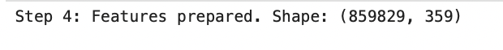
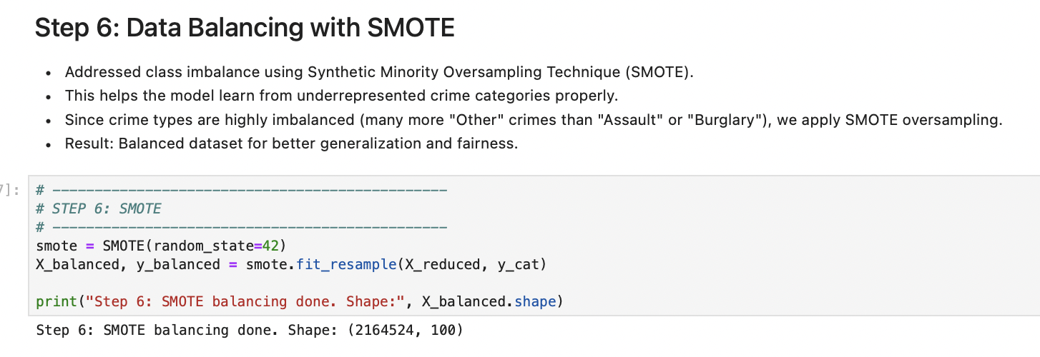
Machine Learning Pipeline
DATA STORAGE
PREPROCESSING
MODEL TRAINING
AUTOMATION
Raw datasets stored in Amazon S3 bucket (mlc-project-1)
Cleaning, feature engineering, and balancing done within SageMaker Studio Notebooks.
Model training (classification or time series) using ML libraries (XGBoost, LightGBM, Statsmodels).
Model evaluation based on accuracy, recall, RMSE, etc.
Entire flow scripted into modular code to enable reproducibility.

Slide 6
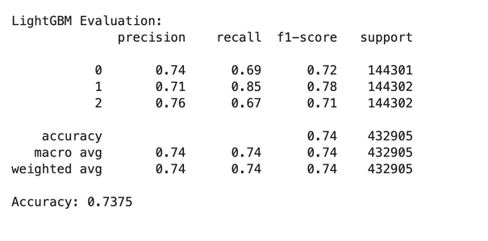
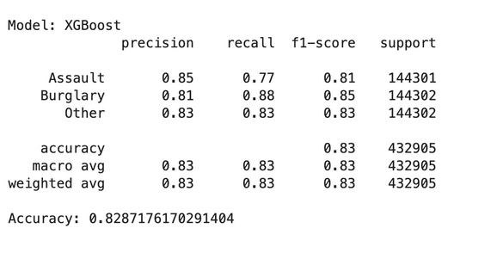
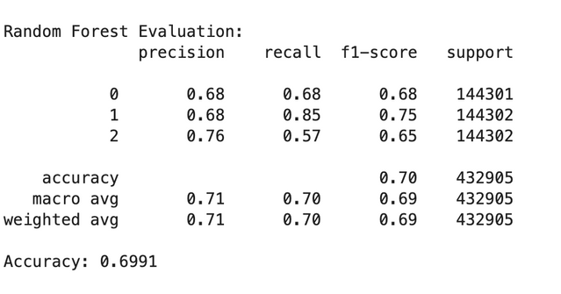
Model Training & Performance Evaluation (Classification)
Used AWS SageMaker Studio to manage model training pipelines.
Trained multiple models:
XGBoost
LightGBM
Random Forest
Applied hyperparameter tuning (e.g., adjusting learning rate, depth) to improve accuracy.
Applied early stopping in XGBoost to avoid overfitting.
Performance Evaluation:
LightGBM: Faster training, better recall than Random Forest. Slightly lower precision on rare crimes.
XGBoost; Best individual model performance. Balanced precision and recall across all classes.
Random Forest: Good recall for frequent crimes but struggles with rare crimes.
.

Slide 7
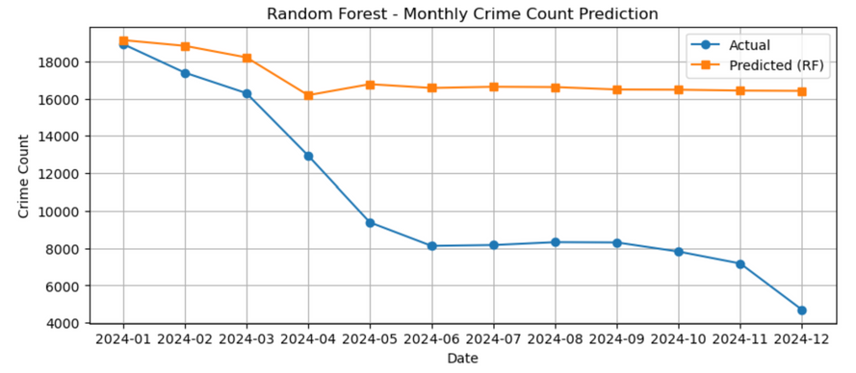
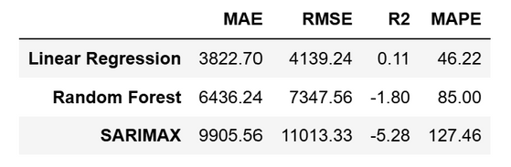
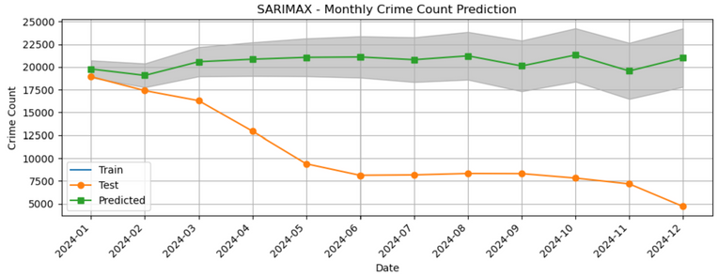
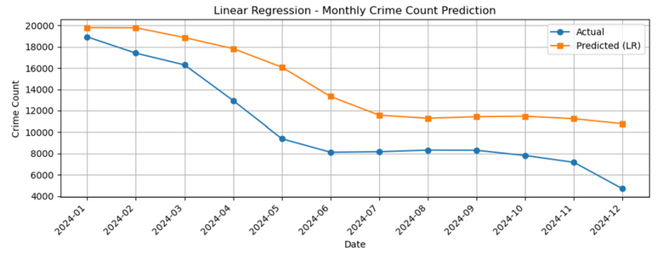
Model Training & Performance Evaluation(Time Series)
Trained time series forecasting models using Prophet and XGBoost Regressor.
Focused on monthly crime count prediction using decomposed trend + seasonality components.
Hyperparameter tuning done for seasonality settings and tree depth in models.
Performance Evaluation:
Linear Regression achieved the best performance in MAE, RMSE, and R², providing the highest interpretability and stability as a baseline model.
Random Forest can capture non-linear relationships but underperformed on this dataset, yielding larger errors and an R² below zero.
SARIMAX, while explicitly modeling seasonality and exogenous variables, resulted in higher errors in this evaluation.

Slide 8

Dimension Reduction Techniques
Classification Model:
Technique Used: Truncated SVD
Justification:
The feature space after one-hot encoding categorical variables (e.g., "Area Name", "Premise Description") resulted in hundreds of dimensions.
High-dimensional data increases model complexity and risks overfitting.
Application:
Reduced features from 400+ dimensions to 150 principal components using Truncated SVD.
Impact:
Reduced feature space to the top 100–150 components, retaining >90% variance.
Improved model generalization.
Reduced training time significantly.
Made XGBoost, LightGBM, and Random Forest models faster and more stable.
Time Series Model:
Dimensionality Reduction Not Applied
In the time series modeling part, traditional dimensionality reduction techniques (e.g., PCA, TruncatedSVD, Autoencoders) were not applied.
Reason:
The time series models only used a small number of predictors:
➔ lag_1, lag_2, lag_3, year, month, etc.
These predictors were carefully selected based on domain knowledge (temporal dependencies) rather than automatic feature engineering.
No strong multicollinearity or high-dimensionality problem was detected that would require dimensionality reduction.
Conclusion:
Since there were only 5–7 predictors, applying PCA or similar techniques would not have yielded meaningful performance gains and could have distorted important temporal signals.

Slide 9
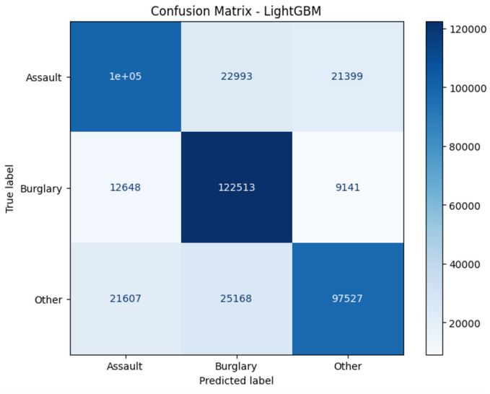
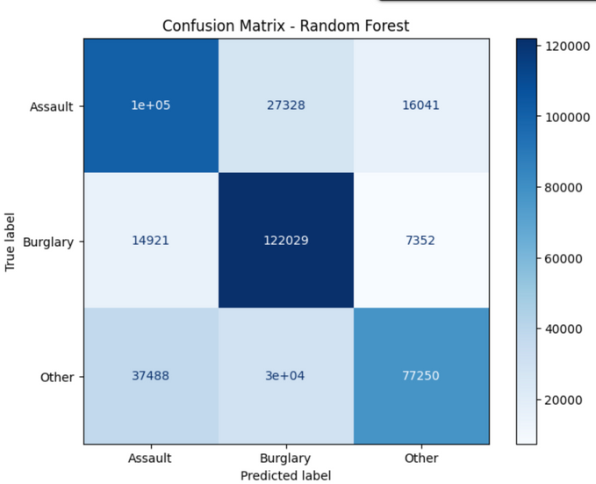
Results (Classification - Crime Type Prediction)
Key Findings:
XGBoost achieved the best performance with an accuracy of ~83%.
LightGBM achieved an accuracy of ~74%, showing good performance but slightly lower than XGBoost.
Random Forest achieved an accuracy of ~70%, indicating it struggled more with the imbalanced and complex patterns.
Strengths:
XGBoost handled class imbalance and captured complex non-linear relationships.
Feature engineering (e.g., time of day, location clustering) significantly improved classification accuracy.
SMOTE oversampling helped balance rare crime types, improving model robustness.
Limitations:
Despite oversampling, the "Other" crime group remains highly diverse, possibly introducing noise.
Spatial features (latitude, longitude) had limitations due to missing or noisy location data.
Future Improvements:
Introduce deeper feature engineering (e.g., weather, special events).
Fine-tune hyperparameters further with automated optimization tools like SageMaker Autopilot.
Experiment with advanced ensemble stacking (e.g., blending XGBoost and LightGBM more carefully).

Slide 10
Results (Time Series - Crime Count Forecasting)
Key Findings:
Linear Regression provided the best performance among the tested models, outperforming Random Forest and SARIMAX in terms of MAE, RMSE, and R².
The forecasting task revealed that crime patterns in monthly aggregation are largely linear, making simpler models more reliable.
Decomposing the time series into trend, seasonality, and residuals improved stability and interpretability.
Strengths:
Simple models like Linear Regression are fast, interpretable, and work well when features capture enough information.
Feature engineering (lag features, month, year) was crucial for capturing both short-term autocorrelation and long-term seasonal effects.
Time series decomposition helped simplify the prediction task by isolating predictable patterns.
Limitations:
Monthly aggregation loses some fine-grained dynamics (e.g., daily spikes or holiday effects).
SARIMAX was sensitive to parameter tuning and underperformed without careful seasonality adjustments.
Future Improvements:
Apply Prophet or deep learning-based sequence models (e.g., LSTM) to capture richer non-linear patterns.
Integrate external data like weather conditions or major events to improve forecasting accuracy.
Use Bayesian Ridge Regression for uncertainty quantification in forecasts.

Slide 11
Thank You!

